Slide 1
Big Mountain Resorts
By Derek Plemons

Slide 2
Problem Identification
Big Mountain Resort is a ski resort in Montana with about 350,000 visitors a year.
The resort recently installed an additional chair lift at a cost of 1.5 million for the current season.
Current costs are based on the market average and currently charging a premium for admission.
Determine a pricing model for the Big Mountain Resort: How to maximize their returns relative to its market position and which facilities matter most to visitors in terms of what they are willing to pay for?

Slide 3
Recommendation and Key Findings
We suggest the Big Mountain Leadership implement Scenario 3.
Big Mountain currently charges $81 per ticket.
The scenario 3 Model supports a ticket price increase of $9.75 to $90.75.
Scenario 1
Close up to 10 of the least used runs
Close 5 runs = $-.6 per ticket
Close 10 runs = $-1.7 per ticket
Scenario 2
Add a run
Increase vertical drop by 150 feet
Additional chair lift
Increase ticket price by $8.46
Scenario 3
Add a run
Increase vertical drop by 150 feet
Additional chair lift
Add 2 acres of snow making
Increase ticket price by $9.75
Scenario 4
Increase longest run by .2 miles
Add 4 acres of snow making
No change in ticket price

Slide 4
Modeling Results
By taking all resorts to be part of the same market share, there was a pattern suggestive of a relationship between state and ticket price.
The features that are correlated to price are fastQuads, Runs, Snow Making_ac, resort_night_skiing_state_ratio, vertical_drop and total_chairs.
We decided to focus on these numerical features for determining price.
However, upon further analysis we found that fastQuads, Runs, Snow Making_ac and vertical drop are the dominant top four features.

Slide 5
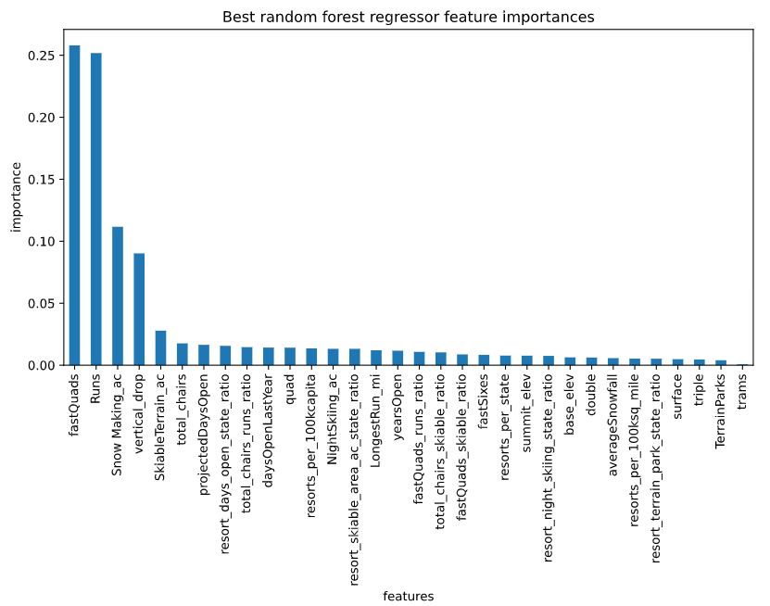
Best Feature by Importance
Top Features:
fastQuads
Runs
Snow Making_ac
Vertical_drop
skiableTerrain_ac
total_chairs

Slide 6
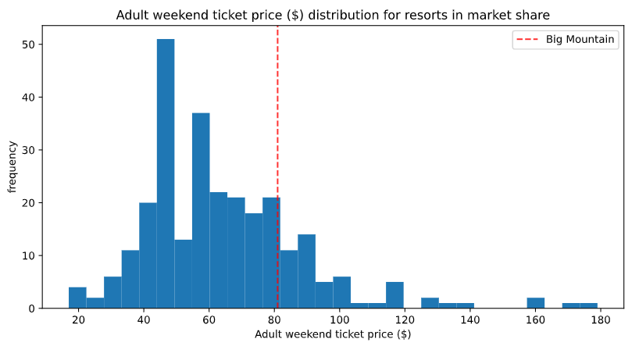
Adult Weekend Ticket
Big Mountains Ticket price when compared with all other resorts in Montana.
Lowest price = ~ $20
Highest price = ~ $180

Slide 7
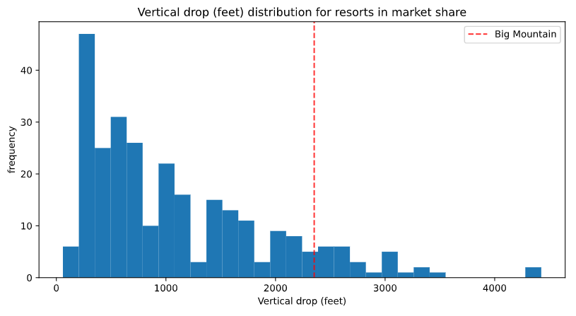
Vertical Drop
Vertical Drop comparison to all other Montana resorts
Big Mountain is doing well for vertical drop
However there are a few resorts with a greater drop

Slide 8
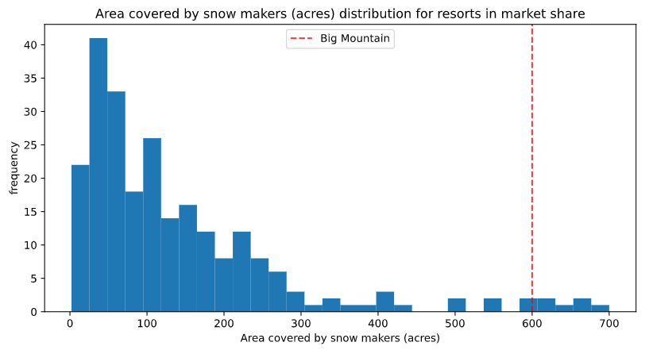
Snow Making Area Covered
Big Mountains snow making capability is high as compared with other resorts in Montana

Slide 9
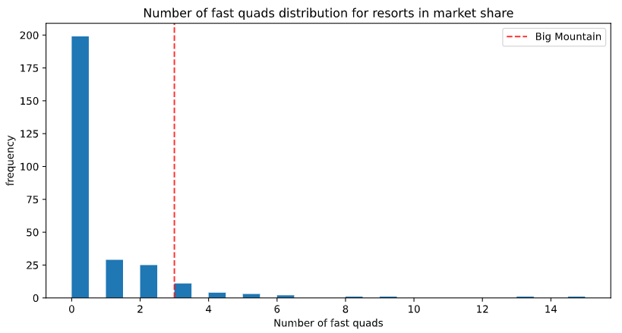
Fast Quads
Most resorts have no Fast Quads
Big Mountain has 3

Slide 10
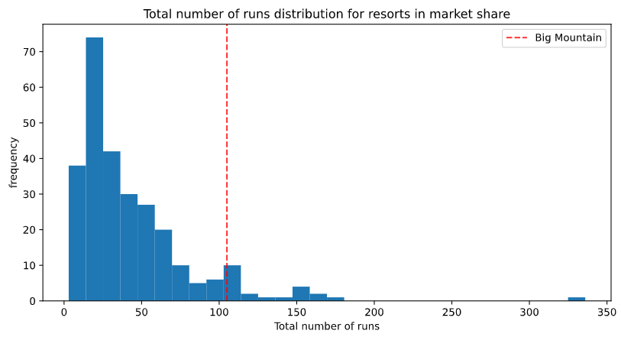
Total Number of Runs
Big mountain ranks high for the number of runs

Slide 11
Summary and Conclusion
In our analysis we found that fastQuads, Runs, Snow Making_ac and vertical drop are the dominant top four features. By modifying the number of these features given in scenario 3, Big mountain can increase ticket price and take full advantage of the features available.
Recommendation:
We suggest the Big Mountain Leadership implement Scenario 3.
The scenario 3 Model supports a ticket price increase of $9.75 to $90.75.
Next Steps:
Operating cost evaluation

